Slide 1
MERGING SPORT & EDUCATION (Good practices)
Jaromír Šimonek
CPU Nitra, Slovakia

Slide 2
GOOD PRACTICES IN SLOVAKIA
History of DC in Slovakia:
Dual Career of Athletes – meeting of EU expert group in Poznań on 28 September 2012
Slovak Ministry of Education, Science, Research and Sport – supported the outcomes of the meeting – offered cooperation with the project
No specific organization or experience with programmes of athletes´ support.

Slide 3
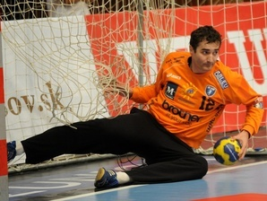
ATHLETES´ NGO´s
LOSS –Slovak Athletes Protection League (2015)
to protect the rights of athletes,
to enforce common interests of professional athletes,
to give advice and consultancy concerning dual career of athletes .
The founders:
Róbert Jano & Richard Štochl
– former Slovak representati-
ves in handball (Dunaferr,
Montpellier, Rhein-Neckar Löwen)

Slide 4
GOOD PRACTICES IN SLOVAKIA
Universities offer scholarships amounting up to 400 eur to successful athletes
50% attendance at lectures
Flexible schedule
Postponement of dates of exams
Free accomodation at youth hostels
Best athlete-students reward at Rector´s Gala

Slide 5
NEGATIVE CASES
Many athletes find themselves in a critical situation when transiting into the common life:
Ladislav Molnár (soccer goalkeeper) – bad investments – tax debts amounting to 112,000 eur
Lajko Lancz, Majo Kopča and Marek Špilár – committed suicide
Peter Babnič (Sparta Prague, U-21 team for Olympic Games) – became addicted to gambling – today he works 12 hrs a day at a factory producing mattresses.
Peter Gunda (Nitra) recommends to all players to save up money since the transition from sport to common life is difficult.

Slide 6
POSITIVE CASES
Dušan Tittel – former soccer player in Bratislava – today boss of the Slovak Soccer Clubs Union – financially supports some former players who are in need. He recommends:
Athletes should attend Coaching courses attended also by managers working with „big money“.

Slide 7
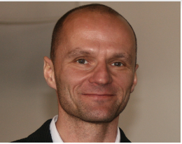
Marián Vanderka
participated at both Winter (bobsleigh) and Summer (sprint) OG
associate professor in Sport Sciences
dean at the FPES CU BA.

Slide 8
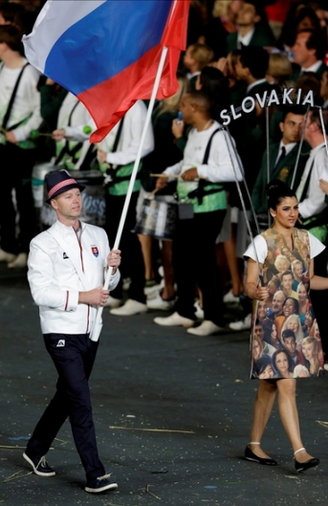
Jozef Gönci
4 times at OG – shooting – bronze medals at OG in 1996 and 2004)
Project manager in the Military Sport Centre Banská Bystrica
Graduated from FPES in Bratislava

Slide 9
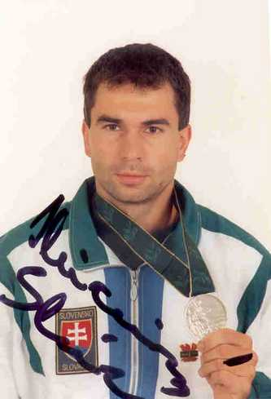
Slavomír Kňazovický
Olympic silver medalist in speed canoeing at 3 OG (1992, 1996 and 2000),
trainer in Military Sport Centre Banská Bystrica
graduated from Secondary Sport School in Trenčín

Slide 10
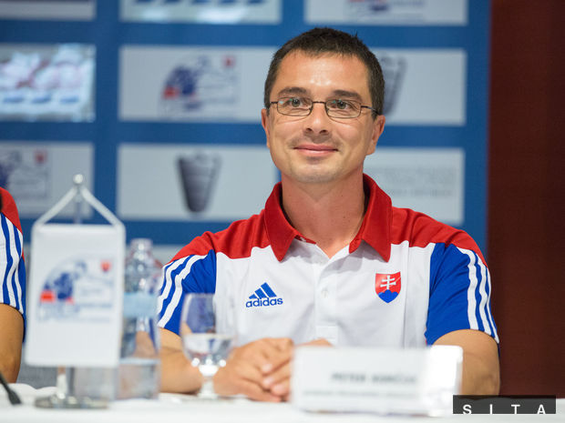
Peter Korčok
- walking, several times at OG,
president of the Slovak Athletic Federation
head of the Slovak Olympic delegation at OG in Rio de Janeiro
PhD graduate

Slide 11

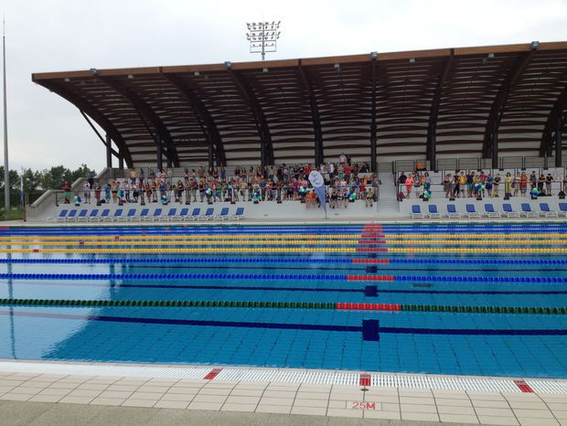
Juraj Bača
Sport Career:
- speed canoeing – several OG
world champion, European champion and olympic medalist
manager of the Elements resort in Šamorín – new multifunctional sport resort Aqua Arena.
Education: Secondary Grammar School in Komárno

Slide 12
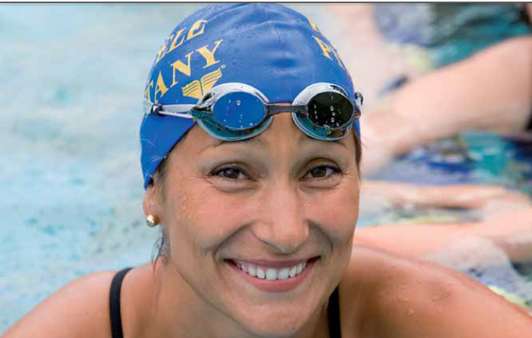
Martina Moravcová
Education: graduated from Secondary Grammar School at Piešťany,
- studied at Economic University in Bratislava, Bussiness Faculty, Bc a Master of Applied Economy.
- studied also at Southern Methodist University, USA (1995-2000) and trained there till the end of her carreer. Very good student – she was introduced into the Hall of Fame of SMU (USA).
Sport: at 15 y. at EC in Antwerp in 1991 won silver and bronze medals. 1 year later she was the youngest Olympic athlete from Czecho-Slovakia at OG in Barcelona.
In 1993 at EC in Sheffield won silver medal (100m).
During her career she won totally 67 medals from WC, EC and OG.
Two silver medals from OG in Sydney 2000, 7-times world champion, 3-times European champion nd 19-times European champion in short pool. She broke 3 world, 17 European and 207 Slovak records. She represented Slovakia at 5 OG (1992-2008).

Slide 13
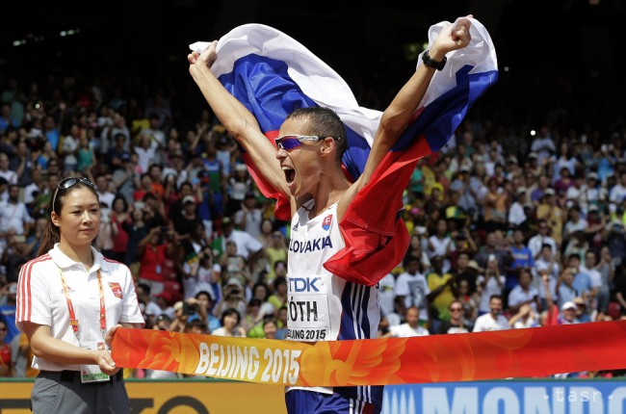
Matej Tóth
World champion in 50 km walking (2015)
Graduated from Faculty of Arts CPU in Nitra, study field: journalism (in 2006)
Coach: Matej Spišiak (since 2013) is a PhD. student at our Department of Physical Education & Sport, Faculty of Education, CPU in Nitra, Slovakia.

Slide 14
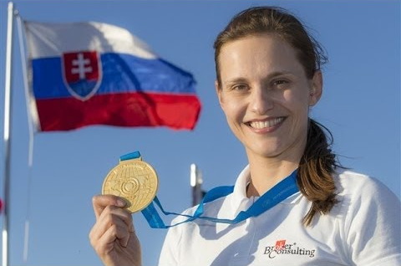
Danka Barteková
World record holder and bronze
medalist from the Summer Olympic
Games in 2012 in shooting (skeet).
In 2013 she became a member of the
International Olympic Committee!
(she is the youngest member).
Education: University in BB, Faculty
of Political Sciences, Diploma work
topic: Sport diplomacy.

Slide 15
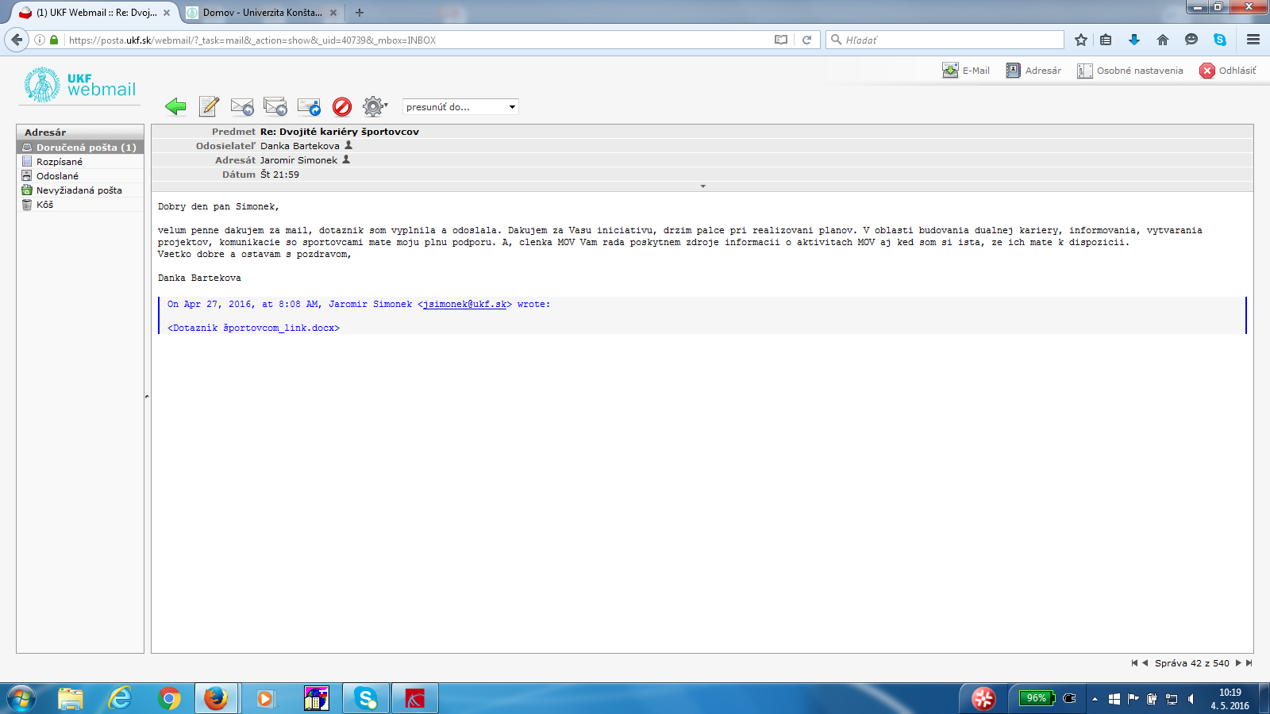
LETTERS OF SUPPORT
Translation: Dear Mr. Šimonek, thank you for your mail, I carefully filled in the questionnaire and send it back. Thank you for your initiative! I keep my fingers crossed for your project plans fulfilment. You have my full support in the area of developing dual career, informing, projects creating and communicating with athletes. As the member of the IOC I will gladly provide you with various sources of information on IOC activities despite the fact that I am sure you have them at your disposal. Remaining with best wishes yours Danka Barteková.

Slide 16
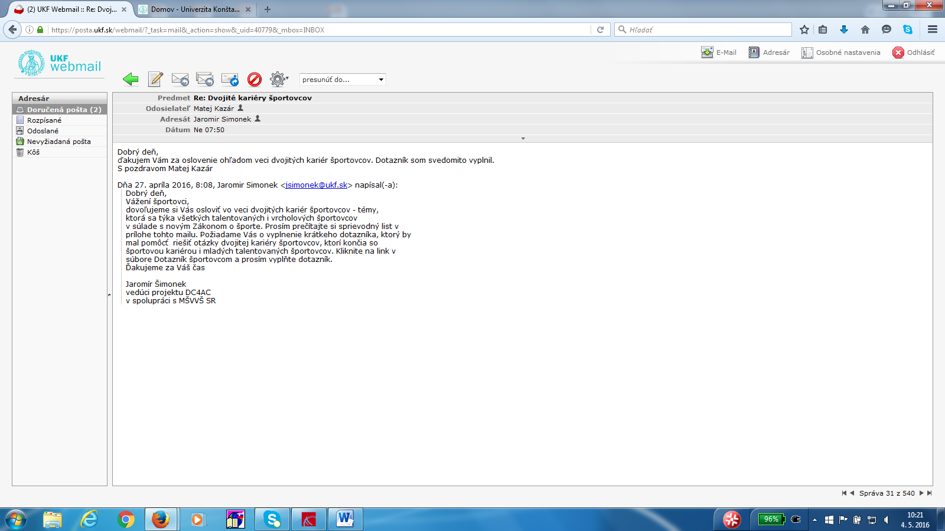
Matej Kazár - biathlon
Translation: Dear Mr. Šimonek, thank you for addressing me concerning dual career of athletes. I carefully filled in your questionnaire. With best regards Matej Kazár.

